Slide 1
VicNicks
By Victor K. Dimitrov & Nicholas M. Ricci

Slide 2
Executive Summary
Business: VicNicks is dedicated to catering to the dynamic needs of the tech community by offering cutting-edge solutions and services. With a focus on innovation and customer satisfaction, VicNicks has established itself as a prominent player in the industry, leveraging expertise and forward-thinking strategies to stay ahead in the rapidly evolving tech landscape.
Problem: VicNicks' rapid growth over the past three years has led to a significant increase in data volume and complexity. Relying on spreadsheet-based data management has become increasingly inadequate and cumbersome, hindering operational efficiency and the company's ability to adapt to evolving market demands.
Solution: VicNicks will modernize its data infrastructure by adopting a comprehensive database solution tailored for rapid growth. This transition from spreadsheets to a sophisticated database architecture will enhance data accessibility, streamline operations, and empower informed decision-making, enabling VicNicks to unlock new opportunities for innovation and growth in the tech industry.

Slide 3
Constraints & Defined Objectives
Constraints:
Limited finances.
Time constraints.
Organizational resistance hinder technological upgrades.
Objectives:
Modernization of VicNicks's data infrastructure, to enhance data accessibility, integrity, and security.
Reduce manual workload and accelerate workflows by implementing automation technologies.
Foster a culture of innovation that empowers employees with actionable insights derived from data analytics, encouraging experimentation, collaboration, and the generation of innovative solutions.

Slide 4
Key Business Rules
One-to-One (1:1) Relationship: Employees are assigned to departments, each overseen by a single manager. This is shown through the links between EMPLOYEE, DEPARTMENT, and MANAGER tables, where the department ID in EMPLOYEE corresponds to DEPARTMENT, and DEPARTMENT's manager ID connects to MANAGER. Additionally, each customer is uniquely identified by their email address in the CUSTOMER table.
One-to-Many (1:M) Relationship: Departments can have multiple employees, illustrated by the DEPARTMENT to EMPLOYEE connection. Each department ID in DEPARTMENT relates to multiple employee records in EMPLOYEE. Similarly, each product is categorized into one category, demonstrated by the PRODUCT_CATEGORY column in the PRODUCT table.
Many-to-Many (M:N) Relationship: Customers can purchase multiple products, reflected in the relationship between CUSTOMER and INVOICE tables. Each invoice can include multiple products bought by a customer, capturing the dynamic interactions between customers and products.

Slide 5
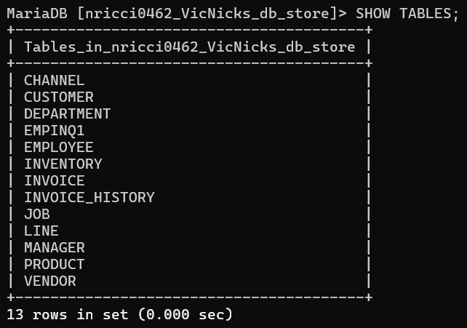
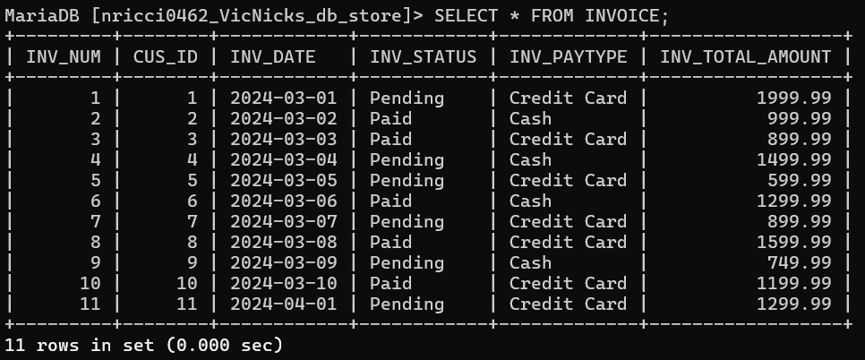
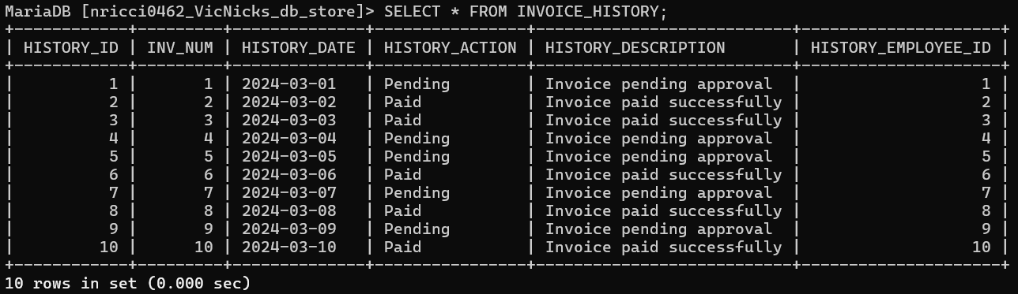
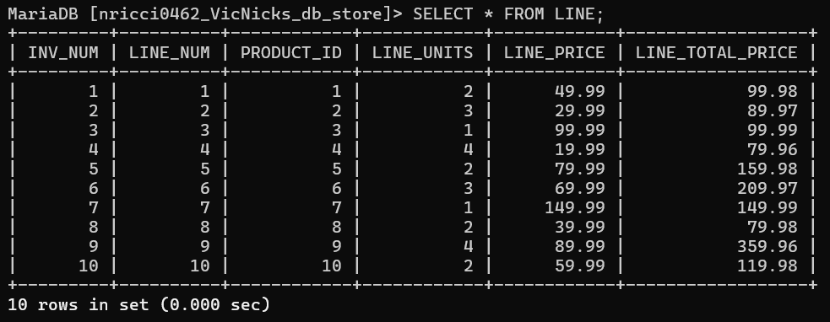
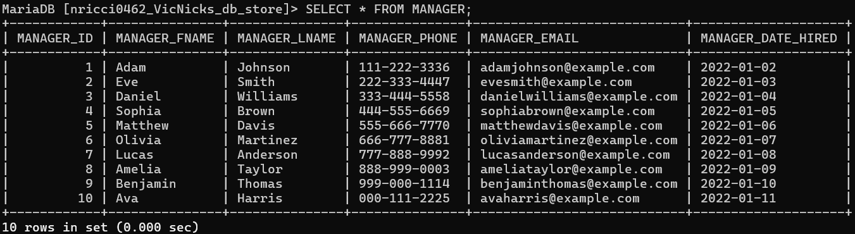
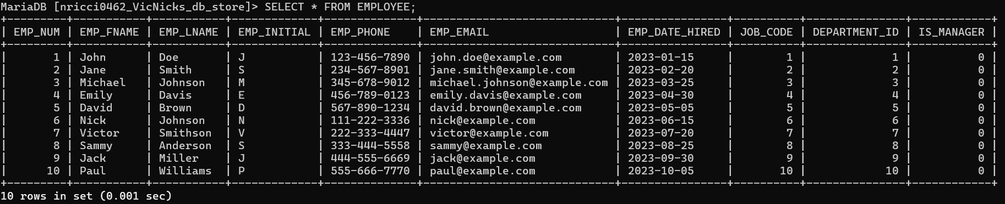
Database Tables and Columns

Slide 6
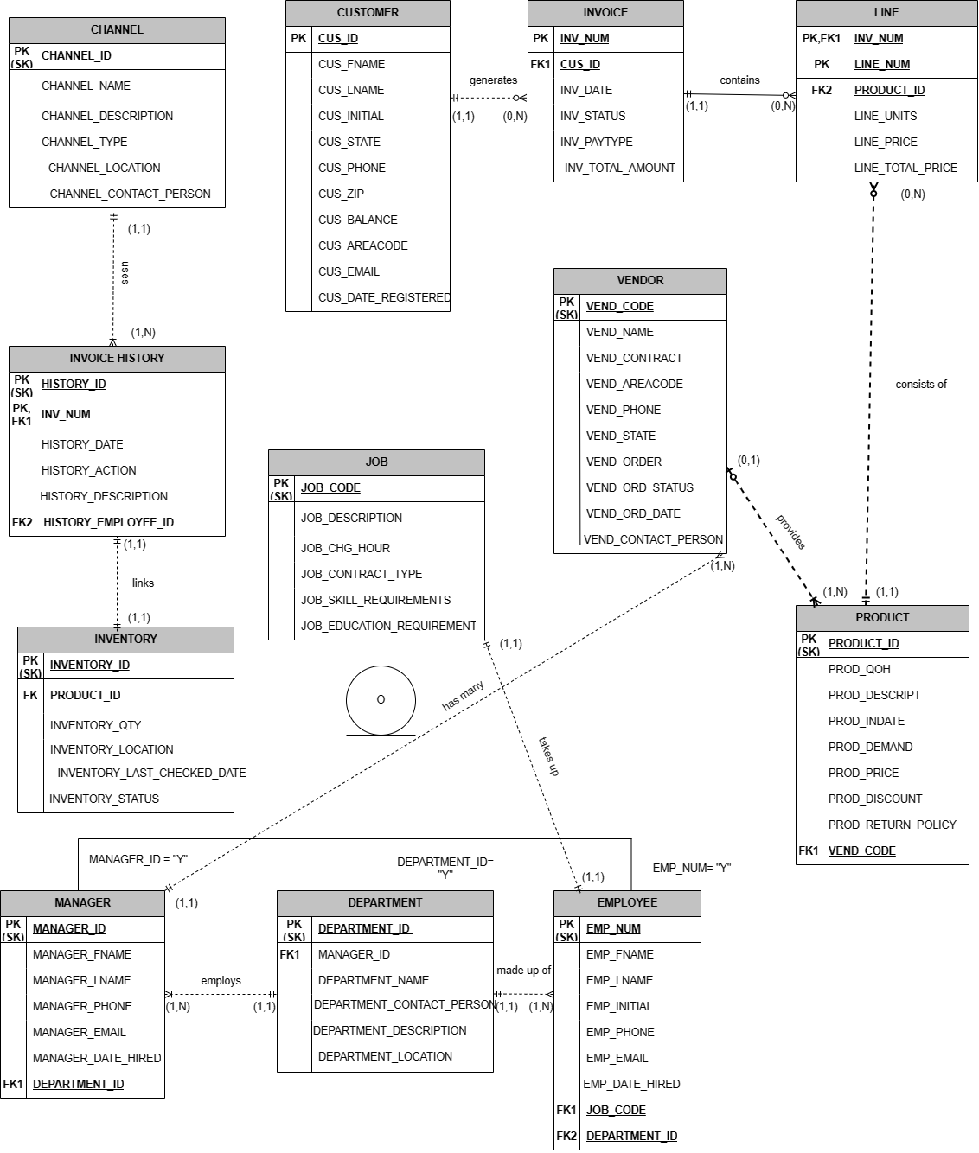
Entity Relationship Diagram (ERD)

Slide 7
Biggest Challenge
Foreign Key Referencing: Managing foreign key constraints posed significant challenges, especially in ensuring referential integrity across related tables.
SQL Code Creation: Crafting SQL code for table creation and defining relationships was complex, requiring precise implementation to avoid errors.
Table Design: Designing tables to capture entity relationships while adhering to constraints was challenging, balancing data normalization, performance optimization, and usability.

Slide 8
Summary of Database Solution
VicNicks' adoption of a comprehensive database solution signifies a significant milestone in its pursuit of operational excellence and sustainable growth.
Transitioning from outdated data management practices to modernization demonstrates VicNicks' proactive approach to navigating the evolving tech landscape.
The meticulously crafted database schema captures crucial aspects of VicNicks' operations, including customer relationship management, sales, and inventory management.
The schema aligns with established business rules and constraints, ensuring reliable data integration and fostering deeper operational insights.
This approach empowers VicNicks to stay agile and responsive in the face of dynamic market conditions.
Leveraging cutting-edge technologies and industry best practices, VicNicks aims to enhance operational efficiency and deliver value to clients and stakeholders.
With a robust foundation in place, VicNicks is poised to lead in the competitive tech landscape, seizing emerging opportunities and overcoming challenges with resilience and foresight.

Slide 9
What we have Learned
Database Design and Foreign Keys: Learned the importance of meticulous database design for data integrity and managing foreign key relationships.
SQL Proficiency: Enhanced skills in crafting SQL queries for data manipulation and consistency.
Team Collaboration and Problem-Solving: Developed effective communication and problem-solving skills, overcoming challenges like foreign key constraints.
Project Management and Adaptability: Gained experience in project planning, execution, and adaptation to changing requirements.
Documentation, Presentation, and Learning: Improved skills in documentation, presentations, and continuous learning for staying updated with database technologies.

